Slide 1

SMU FinTech Bootcamp
Feb. 2022
ARK
INVEST
This project is a quantitative analysis of 5 of the 6 ARK ETFs.

Slide 2
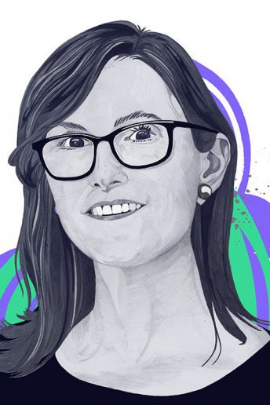

ARK INVEST
ARK Invest
A Brief Story About The Company
Cathie registered ARK Investment Management LLC (“ARK”) as an investment advisor with the U.S. Securities and Exchange Commission in January 2014. With over 40 years of experience identifying and investing in innovation, Cathie founded ARK to focus solely on disruptive innovation while adding new dimensions to research.
Prior to ARK, Cathie spent twelve years at AllianceBernstein as CIO of Global Thematic Strategies where she managed over $5 billion. Cathie joined Alliance Capital from Tupelo Capital Management, a hedge fund she co-founded, which in 2000, managed approximately $800 million in global thematic strategies. Prior to her tenure at Tupelo Capital, she worked for 18 years with Jennison Associates LLC as Chief Economist, Equity Research Analyst, Portfolio Manager, and Director. She started her career in Los Angeles, California at The Capital Group as an Assistant Economist. Cathie received her Bachelor of Science, summa cum laude, in Finance and Economics from the University of Southern California.(ARKFunds)

Slide 3

ARK INVEST
The Vision
This project is a quantitative analysis of 5 of the 6 ARK ETFs. Our goal is to see how much investment potential these ETFs have based on key risk-management metrics: the daily returns, standard deviations, Sharpe ratios, and betas.
We will be working on a Jupyter Notebook and visualizing all of our data using hvplot to create interactive visualizations as well as running an MC Simulation at the end to forecast the returns of these ETFs over the next 30 years.

Slide 4

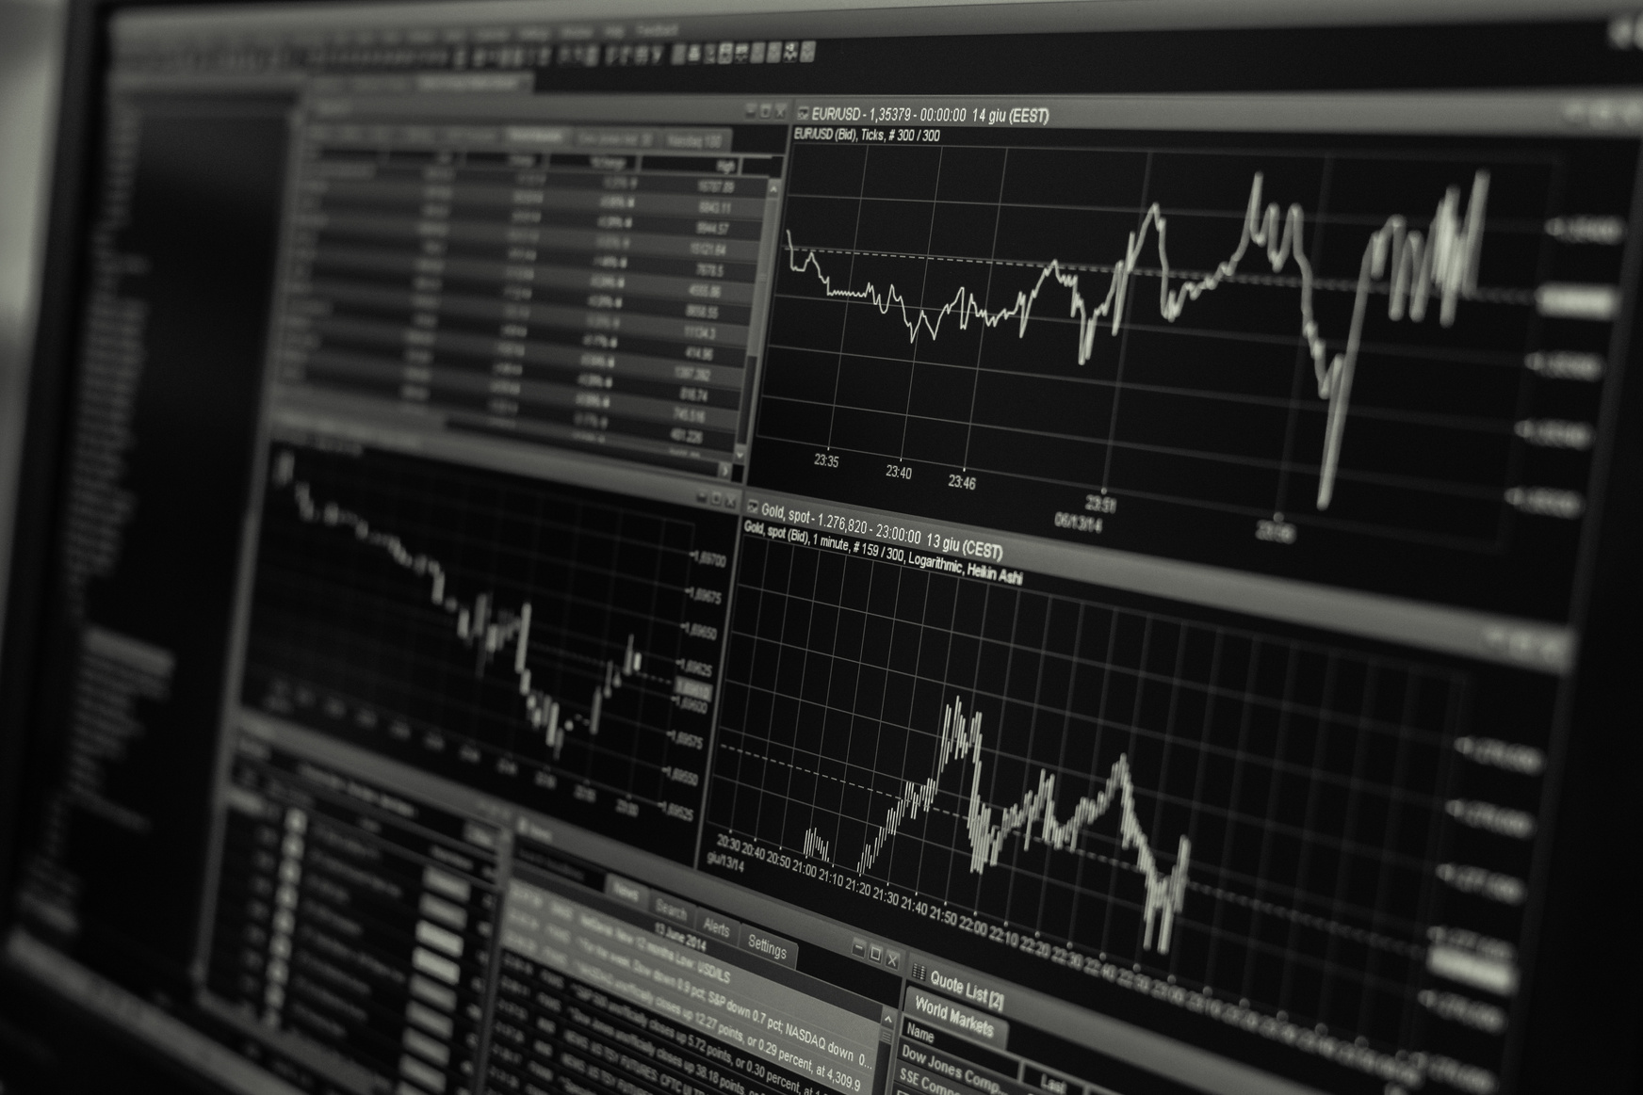
Key Factors
ARK INVEST
01
Analyze the Performance
04
Analyze Risk-Return
Do any of the four fund portfolios outperform the S&P 500 Index?
Which of the four portfolios offers the best risk-return profile? Which offers the worst?
02
Analyze the Volatility
05
DiversifyThe Portfolio
Which fund was the most volatile(with the greatest spread)?
Which was the least volatile (with the smallest spread)?
Which of the two portfolios seem more sensitive to movements in the S&P 500?
Which of the two portfolios do you recommend for inclusion in your firm’s suite of fund offerings?
03
Analyze the Risk
Which portfolios pose more risk than the S&P 500?
Does the risk of each portfolio increase at the same time that the risk of the S&P 500 increases?
Which portfolio poses the most risk? Does this change over time?

Slide 5

ARK INVEST
Analyze the Performance
Do any of the four fund portfolios outperform the S&P 500 Index?

Slide 6
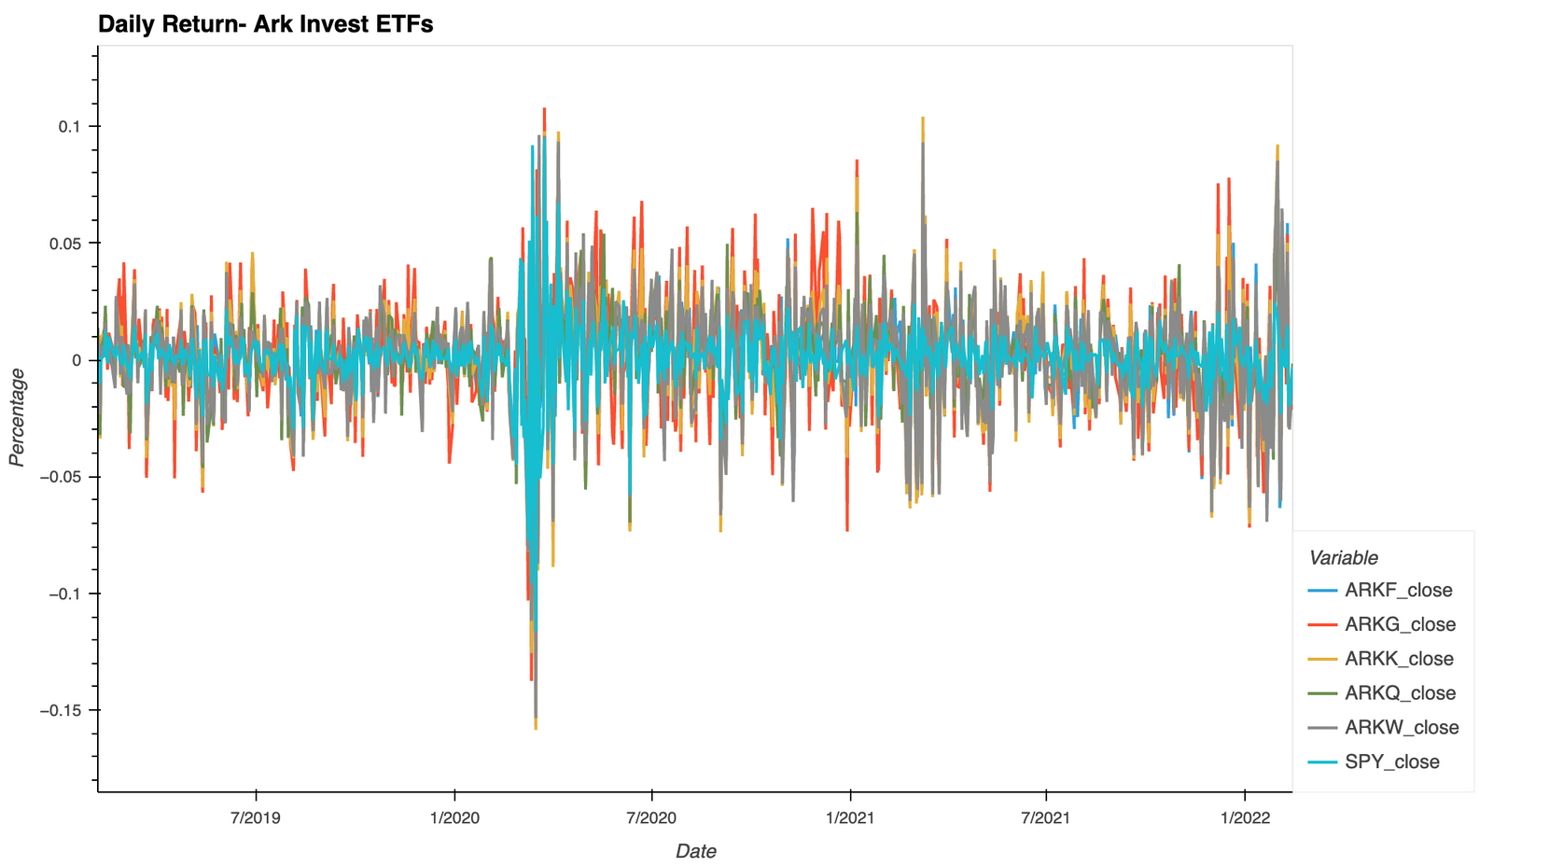
ARK INVEST
Analyze the Performance

Slide 7
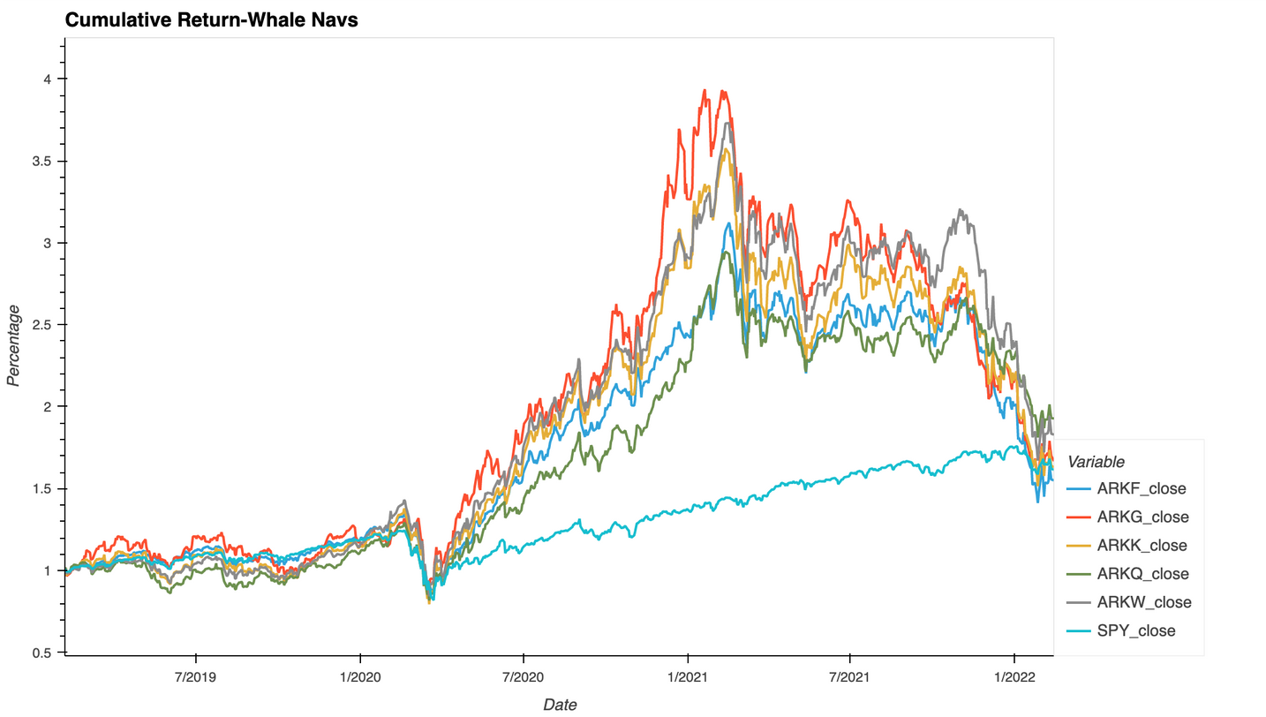
ARK INVEST
Performance Overview
Do any of the four fund portfolios outperform the S&P 500 Index?
All five ETFs outperformed SPY starting from April 2020, they all peaked in January 2021, and in January 2022 they're all back to the SPY level.

Slide 8

ARK INVEST
Analyze the
Volatility
Which fund was the most volatile
(with the greatest spread)?
Which was the least volatile
(with the smallest spread)?

Slide 9
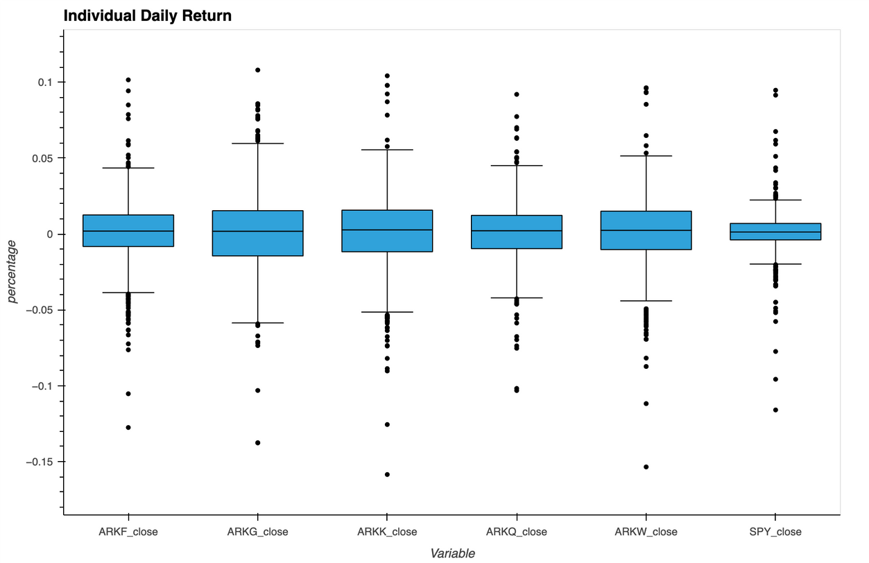
ARK INVEST
Analyze the Volatility
Which portfolios pose more risk than the S&P 500?
BARKK fund was the most volatile
(with the greatest spread).
Does the risk of each portfolio increase at the same time that the risk of the S&P 500 increases?
ARKQ fund was the least volatile
(with the smallest spread).

Slide 10

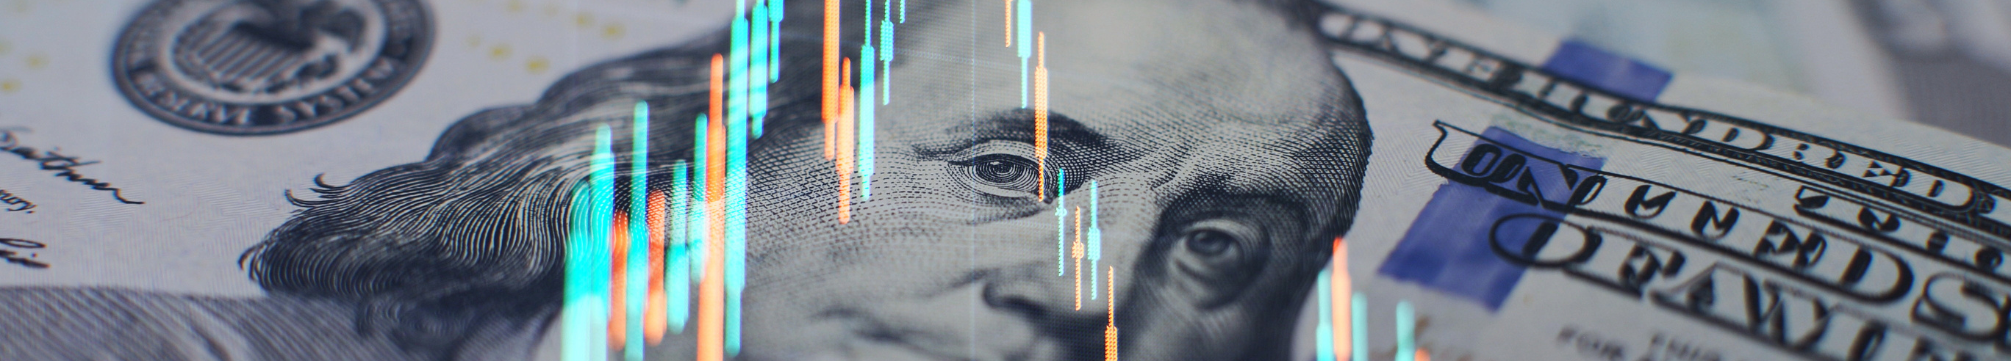
ARK INVEST
Risk Analysis
Which portfolios pose more risk than the S&P 500?
Does the risk of each portfolio increase at the same time that the risk of the S&P 500 increases?
Which portfolio poses the most risk?
Does this change over time?

Slide 11
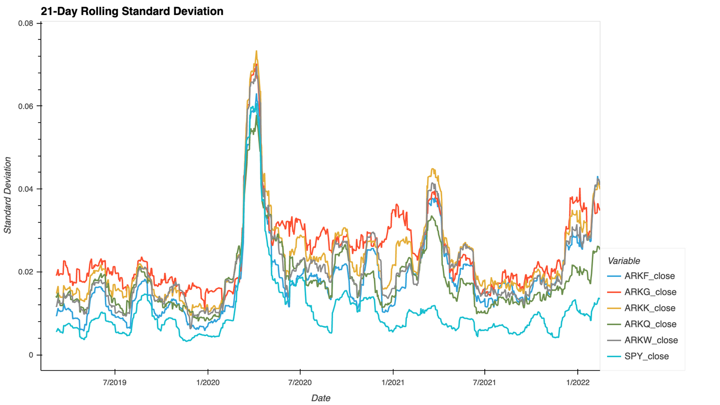
ARK INVEST
Risk Analysis
Which portfolios pose more risk than the S&P 500?
All of the five ETFs pose more risk than the SPY.
Does the risk of each portfolio increase at the same time that the risk of the S&P 500 increases?
Yes, all five ETFs follow the SPY, the correlation between the 5 ETFs and the SPY is very obvious as you see from the chart.
Which portfolio poses the most risk? Does this change over time?
ARKK poses a riskier investment, it topped thrice in three-year chart shown above.

Slide 12

ARK INVEST
Risk-Return
Profile
Which of the four portfolios offers the best risk-return profile?
Which offers the worst?

Slide 13
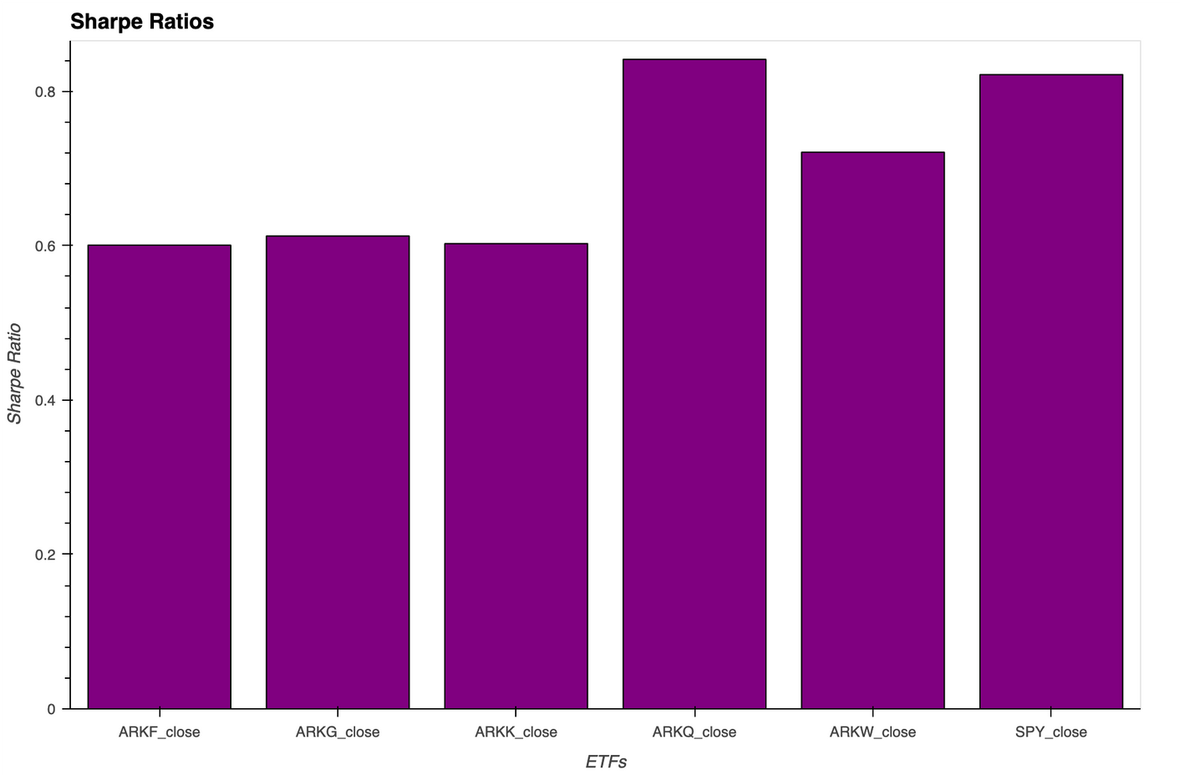
ARK INVEST
Risk-Return Profile
ARKQ has the best risk-return profile, while ARKF has the worst.

Slide 14
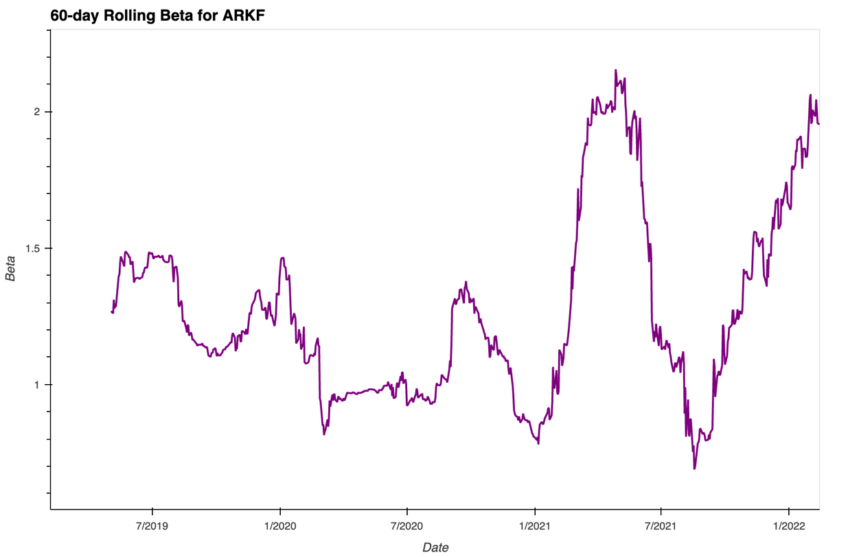
ARK INVEST
Diversify The Profile
Which of the two portfolios seem more sensitive to movements in the S&P 500?
Which of the two portfolios do you recommend for inclusion in your firm’s suite of fund offerings?

Slide 15
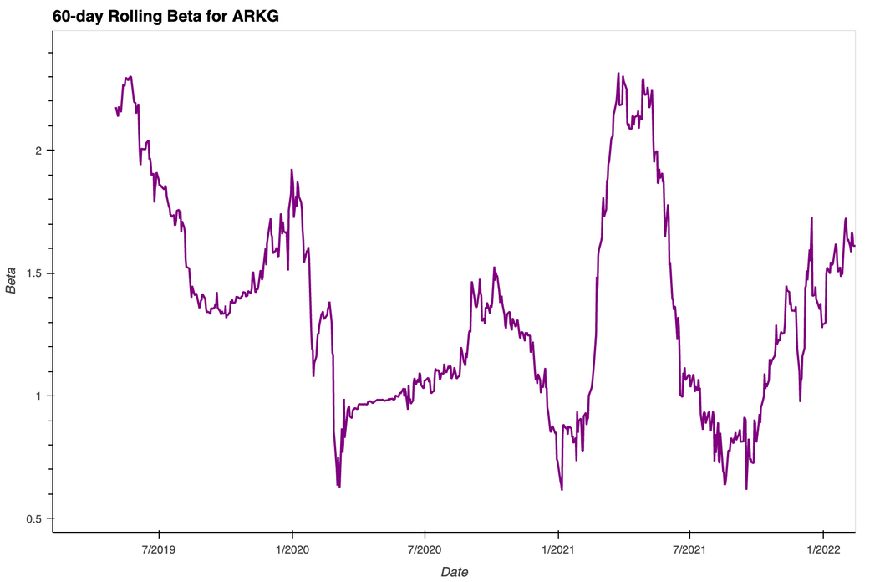
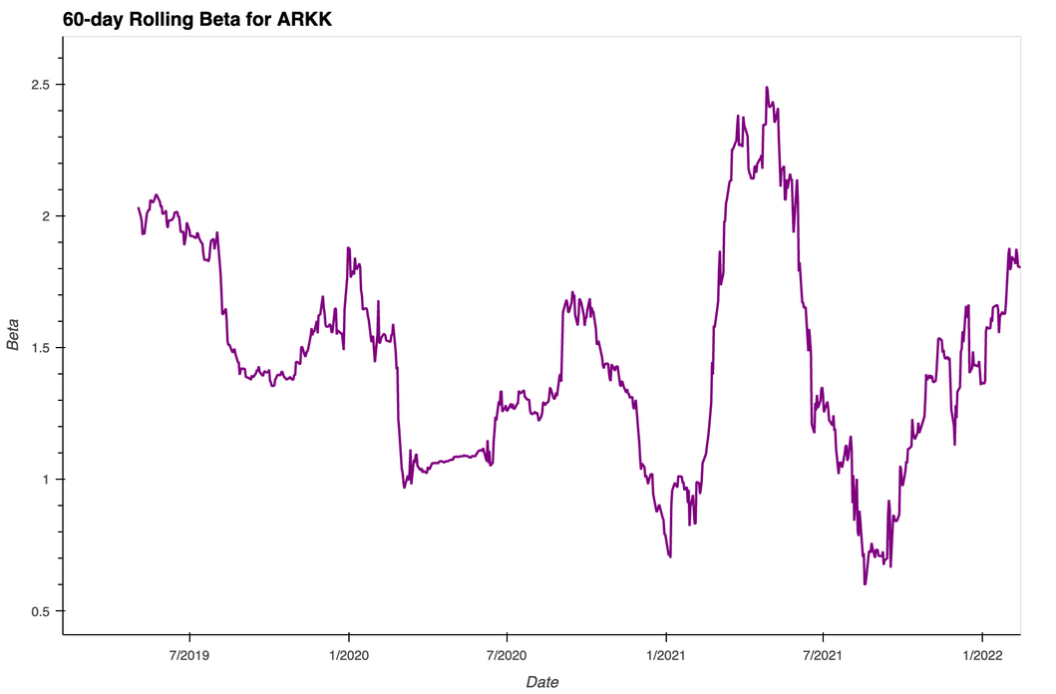
ARK INVEST
Diversify The Profile

Slide 16
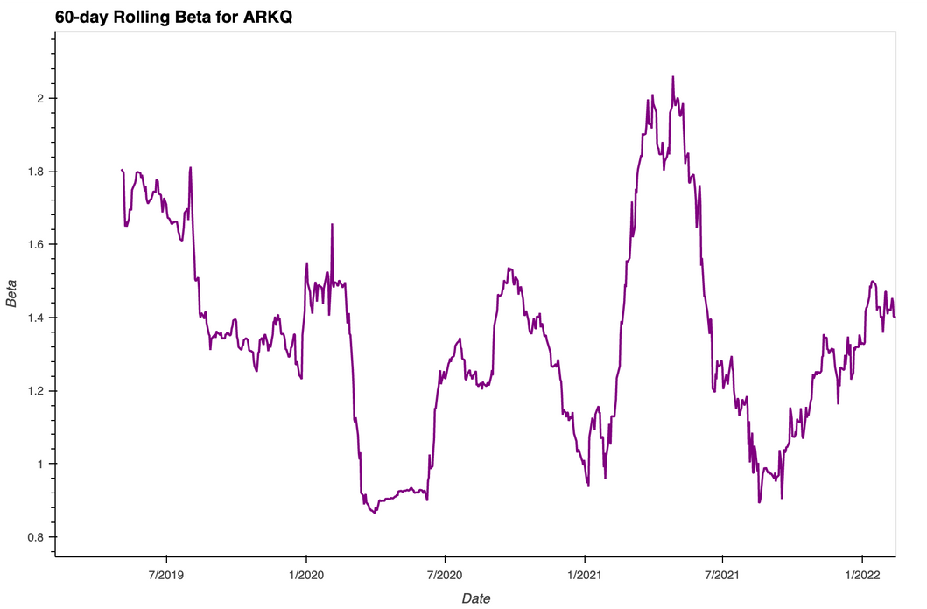
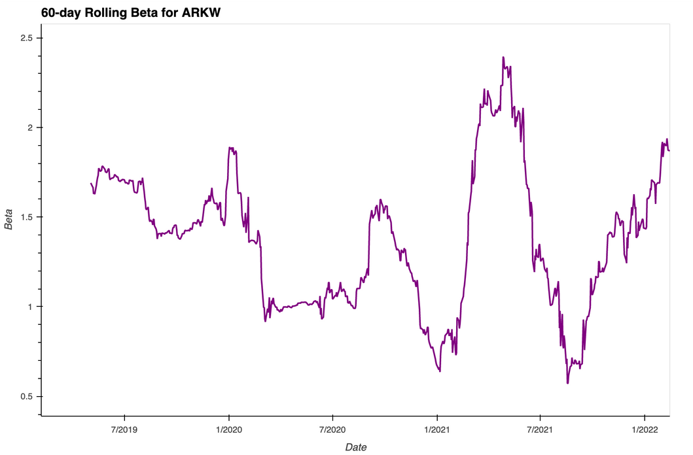
ARK INVEST
Diversify The Profile

Slide 17
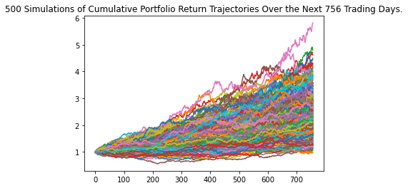
ARK INVEST
Monte Carlo Simulations
2022
2032
2042
2052

Slide 18
ARK INVEST
Our Super Team
Elgin Braggs
Kevin Scott
Omar Eid
James Tagapan

Slide 19
SMU FinTech Bootcamp
Feb. 2022
THANK
YOU
Questions?
We'll now open up the floor for any questions you may have.

